Slide 1

Introductory Computer Networking and IT Security
Week 9

Slide 2
Agenda
Network Threats and mitigation
Concept of AAA and CIA
Recognizing security threats and vulnerabilities
Management of Information Security

Slide 3
Security threats
DoS
Viruses
Worms
Man in the middle
Smurf
Rogue access points
Social engineering (phishing)
Notes:
1

Slide 4
DoS (Denial of Service)
-Makes a system unavailable to its users
-Blocks the access of intended users
-overwhelms or floods the target machine
-consumes significant amount of resources
Notes:
1

Slide 5
DDoS (Distributed Denial of Service)
- Simlar to DoS but much worse
- Botnets attack – group of compromised hosts
- Smurf attack eg: exploiting memcached servers
e.g.: Github DDoS attack, Dyn got hit by more than 1.2Tbps of traffic
Notes:
1

Slide 6
Man in the Middle attack
- sophisticated and targeted attack
- set up a Rogue Access Point
- attacker stays in between the user and internet
- sniffs the user’s traffic and steals credentials
Notes:
1

Slide 7
Social Engineering
Easiest as it attacks the human factor
Getting confidential credentials from victims
Attackers can be highly skilled or not at all
Notes:
1

Slide 8
Malwares
- Viruses
- Worms
- Trojan
- Spyware
- Ransomware
-intends to damage the target system with malicious intent
Notes:
1

Slide 9
Mitigation techniques
Policies and procedures
User training
Patches and updates
Notes:
1

Slide 10
Recognizing security threats and vulnerabilities
Understand common attacks
Inventory your vulnerabilities
Use vulnerability scanning tools
Assess the risks
Notes:
1

Slide 11
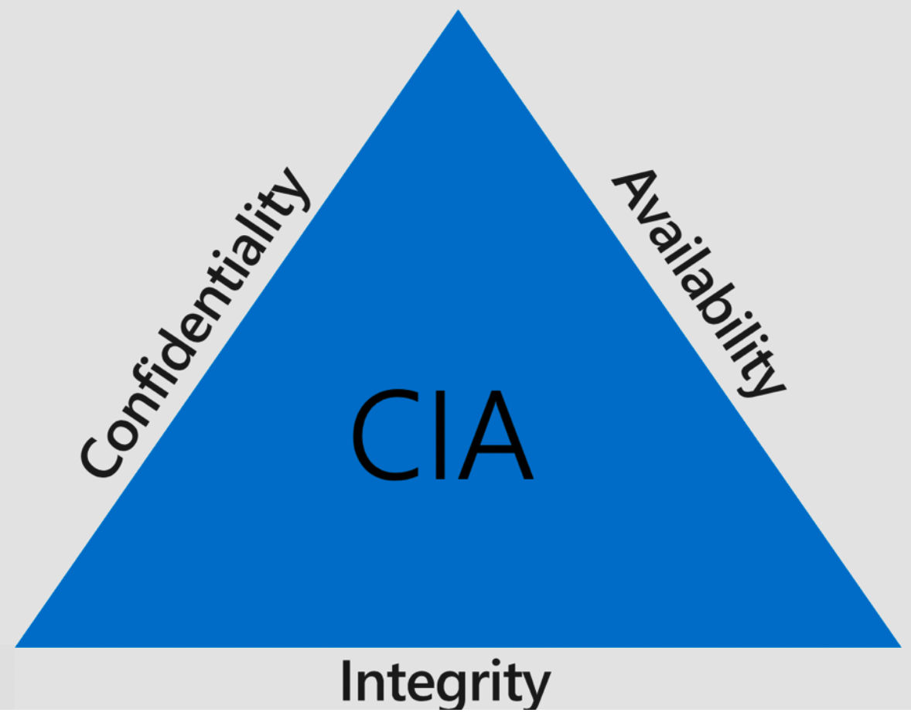
CIA triad
Notes:
1

Slide 12
CIA triad
Confidentiality ensures that the necessary level of secrecy is enforced at each junction of data processing and prevents unauthorized disclosure. This level of confidentiality should prevail while data resides on systems and devices within the network, as it is transmitted, and once it reaches its destination.
    Some examples
      Encryption for data at rest (whole disk, database encryption)
      Encryption for data in transit (IPSec, SSL, PPTP, SSH)
Notes:
1

Slide 13
CIA triad
Integrity is upheld when the assurance of the accuracy and reliability of information and systems is provided and any unauthorized modification is prevented.
  For example, a user may insert incorrect values into a data processing application that ends up charging a customer $3,000 instead of $300
  Some examples
    Hashing (data integrity)
    Configuration management (system integrity)
    Change control (process integrity)
    Access control (physical and technical)
Notes:
1

Slide 14
CIA triad
Availability protection ensures reliability and timely access to data and resources to authorized individuals.
    Networks have so many pieces that must stay up and running (routers, switches, DNS servers, DHCP servers, proxies, firewalls). Software has many components that must be executing in a healthy manner (operating system, applications, antimalware software). There are environmental aspects that can negatively affect an organization’s operations (fire, flood, HVAC issues, electrical problems), potential natural disasters, and physical theft or attacks.
    Some examples
      Redundant array of inexpensive disks (RAID)
      Clustering
      Load balancing
      Redundant data and power lines
Notes:
1

Slide 15
CIA triad
Key Concept beyond CIA triad
  Privacy
    Information is to be used only for purposes known to the data owner.
    This does not focus on freedom from observation, but rather that information will be used only in ways known to the owner.
  Identification
    describes a method of ensuring that a subject (user, program, or process) is the entity it claims to be
    Identification can be provided with the use of a username or account number.
Notes:
1

Slide 16
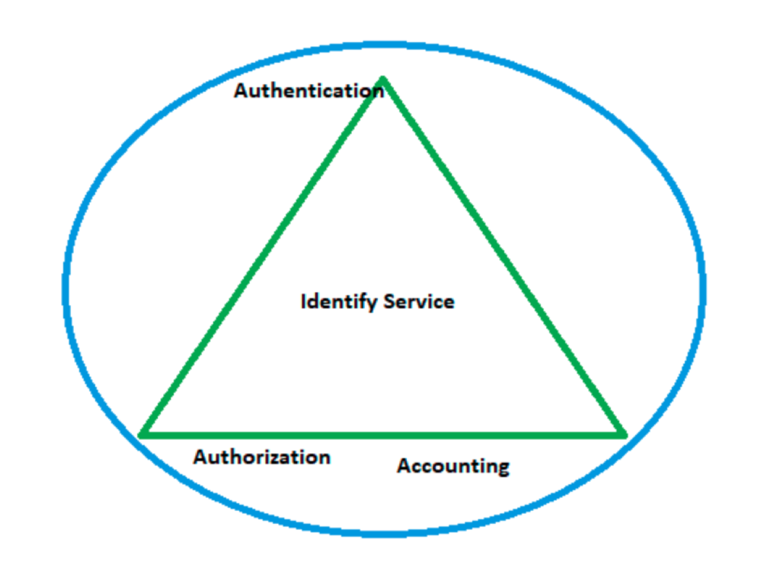
AAA
Notes:
1

Slide 17
AAA
Authentication
  Authentication occurs when a control provides proof that a user possesses the identity that he or she claims.
  Examples
    Verifying the identification information
    Passphrase, PIN value, biometric, one-time password, password
  Protocol Examples
    PAP, CHAP
Notes:
Password Authentication Protocol, Challenge Handshake Authentication Protocol
1

Slide 18
AAA
Authentication and Identification
  Once a person has been identified through the user ID or a similar value, she must be authenticated, which means she must prove she is who she says she is.
  Three general factors can be used for authentication: something a person knows, something a person has, and something a person is.
Notes:
1

Slide 19
AAA
Authorizations
  Now that I know who you are, let’s see if I will let you do what you want.
  After the identity of a user is authenticated, a process called authorization provides assurance that the user (whether a person or a computer) has been specifically and explicitly authorized by the proper authority to access, update, or delete the contents of an information asset.
Notes:
1

Slide 20
AAA
Accounting
  The characteristic of accountability exists when a control provides assurance that every activity undertaken can be attributed to a named person or automated process.
  Examples
    TACACS+, RADIUS accounting
Notes:
Terminal Access Controller Access Control System, Remote Authentication Dial-in User Service
1

Slide 21
CNSS Security Model
Previously called National Training Standard for Information Systems Security Professionals (NSTISSI)
The model, created by John McCumber in 1991
Also Known as McCumber Cube.
If extrapolated, the three dimensions of each axis become a 3 3 3 cube with 27 cells representing areas that must be addressed to secure today’s information systems.
Notes:
1

Slide 22
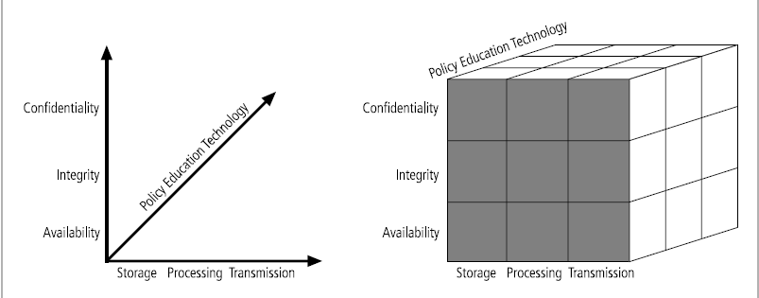
The McCumber Cube
Notes:
1

Slide 23
The McCumber Cube
Desired goals
  Confidentiality: assurance that sensitive information is not intentionally or accidentally disclosed to unauthorized individuals.
  Integrity: assurance that information is not intentionally or accidentally modified in such a way as to call into question its reliability.
  Availability: ensuring that authorized individuals have both timely and reliable access to data and other resources when needed
Notes:
1

Slide 24
The McCumber Cube
Information states
  Storage: Data at rest (DAR) in an information system, such as that stored in memory or on a magnetic tape or disk.
  Transmission: transferring data between information systems - also known as data in transit (DIT).
  Processing: performing operations on data in order to achieve a desired objective.
Notes:
<number>

Slide 25
The McCumber Cube
Safeguards
  Policy and practices: acceptable use policies or incident response procedures
  Human factors: ensuring that the users of information systems are aware of their roles and responsibilities (end-user training on avoiding computer virus infections or recognizing social engineering tactics)
  Technology: software and hardware-based solutions designed to protect information systems (examples: anti-virus, firewalls, intrusion detection systems, etc.)
Notes:
<number>

Slide 26
Thank you
Notes:
<number>

